Slide 1
DATABASE PROJECT Submitted To: Mehrnoush Ashrafi
By :-
SHAMINDER KAUR (C0736231)
MONIKA (C0737547)
HARPREET SINGH(C0738122)
HARVINDER SINGH (C0738812)

Slide 2
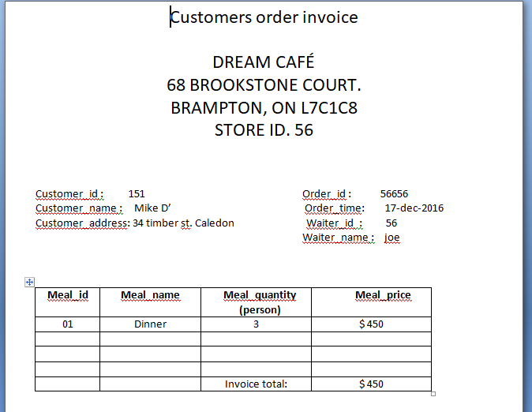
CUSTOMERS ORDER INVOICE

Slide 3
Database Identification
Identifying the Entities and Attributes
CUSTOMER (customer_id, customer_name , customer_phone, customer_address )
CHEF(chef_id , chef_name , chef_salary ,chef_hiredate)
CAFE (café_id , café_name , café_address , café_phone)
MEAL(meal_id , meal_name , meal_price, meal_tax)
WAITER (waiter_id , waiter_name , waiter_salary , waiter_hiredate)
ORDERS(order_id , order_quality , order_quantity , order_time, order_totalprice )

Slide 4
Normalization (1NF)
CUSTOMER (customer_id, customer_name , customer_phone, customer_address , waiter_id)
CHEF(chef_id , chef_name , chef_salary ,chef_hiredate)
CAFE (café_id , café_name , café_address , café_phone)
MEAL(meal_id , meal_name , meal_price, meal_tax,chef_id )
WAITER (waiter_id , waiter_name , waiter_salary, waiter_hiredate )
ORDERS(order_id , order_quality , order_quantity , order_totalprice, order_time, customer_id , waiter_id , meal_id)

Slide 5
2NF: Removing partial dependency
CUSTOMER (customer_id, customer_name , customer_phone, customer_address , waiter_id)
CHEF(chef_id , chef_name , chef_salary ,chef_hiredate)
CAFE (café_id , café_name , café_address , café_phone)
MEAL(meal_id , meal_name , meal_price, meal_tax,chef_id )
WAITER (waiter_id , waiter_name , waiter_salary, waiter_hiredate )
ORDERS(orders_id , orders_time, customer_id , waiter_id , meal_id)
ORDERS_DETAIL(orders_id, meal_id, , orders_quality , orders_quantity ,orders_totalprice )

Slide 6
3NF: Removing transitive dependency
CUSTOMER (customer_id, customer_name , customer_phone, customer_address , waiter_id)
CHEF(chef_id , chef_name , chef_salary ,chef_hiredate)
CAFE (café_id , café_name , café_address , café_phone)
MEAL(meal_id , meal_name , meal_price, meal_tax,chef_id )
WAITER (waiter_id , waiter_name , waiter_salary, waiter_hiredate )
ORDERS(orders_id, orders_status , orders_time, customer_id , waiter_id , meal_id)
ORDERS_DETAIL(orders_id, meal_id, , orders_quality , orders_quantity ,orders_totalprice )
PRICE(orders_id, meal_id, orders_totalprice , meal_tax, , meal_price)

Slide 7
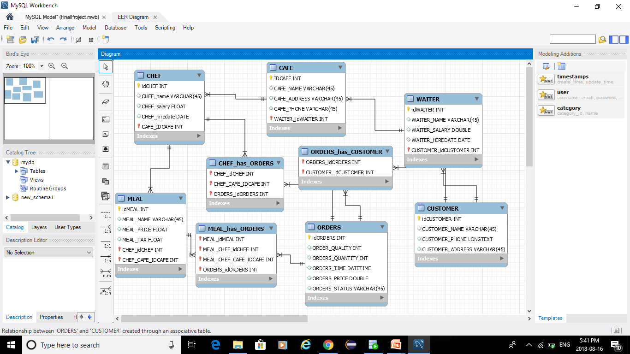
ER DIAGRAM

Slide 8
BUSINESS RULES AND CONSTRAINTS:-
Order_date must be a significant date in past.
Customer_id must be stand-out.
Extended_price must not be lesser than meal_price.
No cell should be invalid.
Foreign keys must be set to deal with the correct data keep up associations between components.
Order_id should remain same in one order_details table.
Calculation of total price must be performed toward the complete of demand and ought to have been appeared on the receipt figuratively speaking.

Slide 9
CREATE TABLE Statements:-
CREATE TABLE "SYSTEM"."CUSTOMER"
( "CUSTOMER_ID" NUMBER(*,0) NOT NULL ENABLE,
"CUSTOMER_NAME" VARCHAR2(20 BYTE) NOT NULL ENABLE,
"CUSTOMER_ADDRESS" VARCHAR2(40 BYTE),
"CUSTOMER_PHONE" NUMBER(*,0),
CONSTRAINT "CUSTOMER_PK" PRIMARY KEY ("CUSTOMER_ID");
CREATE TABLE "SYSTEM"."CAFE"
( "CAFE_ID" NUMBER(*,0) NOT NULL ENABLE,
"CAFE_NAME" VARCHAR2(20 BYTE) NOT NULL ENABLE,
"CAFÉ_ADDRESS" VARCHAR2(50 BYTE),
"CAFE_PHONE" NUMBER(*,0) NOT NULL ENABLE,
CONSTRAINT "CAFE_PK" PRIMARY KEY ("CAFE_ID");
CREATE TABLE "SYSTEM"."WAITER"
( "WAITER_ID" NUMBER(*,0) NOT NULL ENABLE,
"WAITER_NAME" VARCHAR2(20 BYTE) NOT NULL ENABLE,
"WAITER_SALARY" FLOAT(126) NOT NULL ENABLE,
"WAITER_HIREDATE" DATE NOT NULL ENABLE,
CONSTRAINT "WAITER_PK" PRIMARY KEY ("WAITER_ID");

Slide 10
CONTINOUSE:-
CREATE TABLE "SYSTEM"."CHEF"
( "CHEF_ID" NUMBER(*,0) NOT NULL ENABLE,
"CHEF_NAME" VARCHAR2(20 BYTE) NOT NULL ENABLE,
"CHEF_SALARY" FLOAT(126) NOT NULL ENABLE,
"CHEF_HIREDATE" DATE,
CONSTRAINT "CHEF_PK" PRIMARY KEY ("CHEF_ID");
CREATE TABLE "SYSTEM"."MEAL"
( "MEAL_ID" NUMBER(*,0) NOT NULL ENABLE,
"MEAL_NAME" VARCHAR2(20 BYTE) NOT NULL ENABLE,
"MEAL_PRICE" FLOAT(126) NOT NULL ENABLE,
"MEAL_TAX" FLOAT(126) NOT NULL ENABLE,
CONSTRAINT "MEAL_PK" PRIMARY KEY ("MEAL_ID");
CREATE TABLE "SYSTEM"."ORDERS"
( "ORDER_ID" NUMBER(*,0) NOT NULL ENABLE,
"ORDER_QUANTITY" NUMBER,
"ORDER_QUALITY" VARCHAR2(20 BYTE),
"ORDER_TOTALPRICE" FLOAT(126),
CONSTRAINT "ORDERS_PK" PRIMARY KEY ("ORDER_ID")

Slide 11
INSERTION:-
INSERT INTO "SYSTEM"."CAFE" (CAFE_ID, CAFE_NAME, CAFE_ADDRESS, CAFE_PHONE) VALUES ('105', 'DREAM CAFE', '68 BROOKSTONE AVE. , BRAMBPTON', '2159871532')
INSERT INTO "SYSTEM"."CAFE" (CAFE_ID, CAFE_NAME, CAFE_ADDRESS, CAFE_PHONE) VALUES ('109', 'CLOUD CAFE', '23 STEELS VIEW. , TORONTO', '5213694857')
INSERT INTO "SYSTEM"."CHEF" (CHEF_ID, CHEF_NAME, CHEF_SALARY, CHEF_HIREDATE) VALUES ('63', 'BELLA', '9500.99', TO_DATE('2017-09-12 00:00:00', 'YYYY-MM-DD HH24:MI:SS'))
INSERT INTO "SYSTEM"."CHEF" (CHEF_ID, CHEF_NAME, CHEF_SALARY, CHEF_HIREDATE) VALUES ('64', 'SAM', '9999.05', TO_DATE('2016-04-24 00:00:00', 'YYYY-MM-DD HH24:MI:SS'))
INSERT INTO "SYSTEM"."CHEF" (CHEF_ID, CHEF_NAME, CHEF_SALARY, CHEF_HIREDATE) VALUES ('68', 'AMAN', '10000.2', TO_DATE('2017-11-11 00:00:00', 'YYYY-MM-DD HH24:MI:SS'))
INSERT INTO "SYSTEM"."CHEF" (CHEF_ID, CHEF_NAME, CHEF_SALARY, CHEF_HIREDATE) VALUES ('69', 'MANDY', '11264', TO_DATE('2016-01-30 17:41:07', 'YYYY-MM-DD HH24:MI:SS'))
INSERT INTO "SYSTEM"."CUSTOMER" (CUSTOMER_ID, CUSTOMER_NAME, CUSTOMER_ADDRESS) VALUES ('151', 'MIKE D''', '34 TIMBER ST. , CALEDON')
INSERT INTO "SYSTEM"."CUSTOMER" (CUSTOMER_ID, CUSTOMER_NAME, CUSTOMER_ADDRESS, CUSTOMER_PHONE) VALUES ('153', 'DAV TATLA', '56 SHADY PINE.', '3256987456')
INSERT INTO "SYSTEM"."CUSTOMER" (CUSTOMER_ID, CUSTOMER_NAME, CUSTOMER_ADDRESS, CUSTOMER_PHONE) VALUES ('159', 'ABBY', '98 FINCH AVE. EAST', '2453699874')

Slide 12
Continues :-
INSERT INTO "SYSTEM"."MEAL" (MEAL_ID, MEAL_NAME, MEAL_PRICE, MEAL_TAX) VALUES ('1', 'DINNER', '99.99', '.05')
INSERT INTO "SYSTEM"."MEAL" (MEAL_ID, MEAL_NAME, MEAL_PRICE, MEAL_TAX) VALUES ('2', 'LUNCH', '56', '.09')
INSERT INTO "SYSTEM"."MEAL" (MEAL_ID, MEAL_NAME, MEAL_PRICE, MEAL_TAX) VALUES ('3', 'BREAKFAST', '20.34', '.34')
INSERT INTO "SYSTEM"."MEAL" (MEAL_ID, MEAL_NAME, MEAL_PRICE, MEAL_TAX) VALUES ('4', 'BRUNCH', '33.89', '.12')
INSERT INTO "SYSTEM"."ORDERS" (ORDER_ID, ORDER_QUANTITY, ORDER_QUALITY, ORDER_TOTALPRICE) VALUES ('345', '1', 'FINE', '152.00')
INSERT INTO "SYSTEM"."ORDERS" (ORDER_ID, ORDER_QUANTITY, ORDER_QUALITY, ORDER_TOTALPRICE) VALUES ('566', '5', 'GOOD', '485')
INSERT INTO "SYSTEM"."ORDERS" (ORDER_ID, ORDER_QUANTITY, ORDER_QUALITY, ORDER_TOTALPRICE) VALUES ('678', '3', 'MEDIUM', '293.22')
INSERT INTO "SYSTEM"."WAITER" (WAITER_ID, WAITER_NAME, WAITER_SALARY, WAITER_HIREDATE) VALUES ('51', 'KAVI', '6532.25', TO_DATE('2017-01-12 00:00:00', 'YYYY-MM-DD HH24:MI:SS'))
INSERT INTO "SYSTEM"."WAITER" (WAITER_ID, WAITER_NAME, WAITER_SALARY, WAITER_HIREDATE) VALUES ('56', 'JOE', '5500', TO_DATE('2016-03-17 00:00:00', 'YYYY-MM-DD HH24:MI:SS'))
INSERT INTO "SYSTEM"."WAITER" (WAITER_ID, WAITER_NAME, WAITER_SALARY, WAITER_HIREDATE) VALUES ('57', 'NAV', '6600.21', TO_DATE('2016-12-30 00:00:00', 'YYYY-MM-DD HH24:MI:SS'))

Slide 13
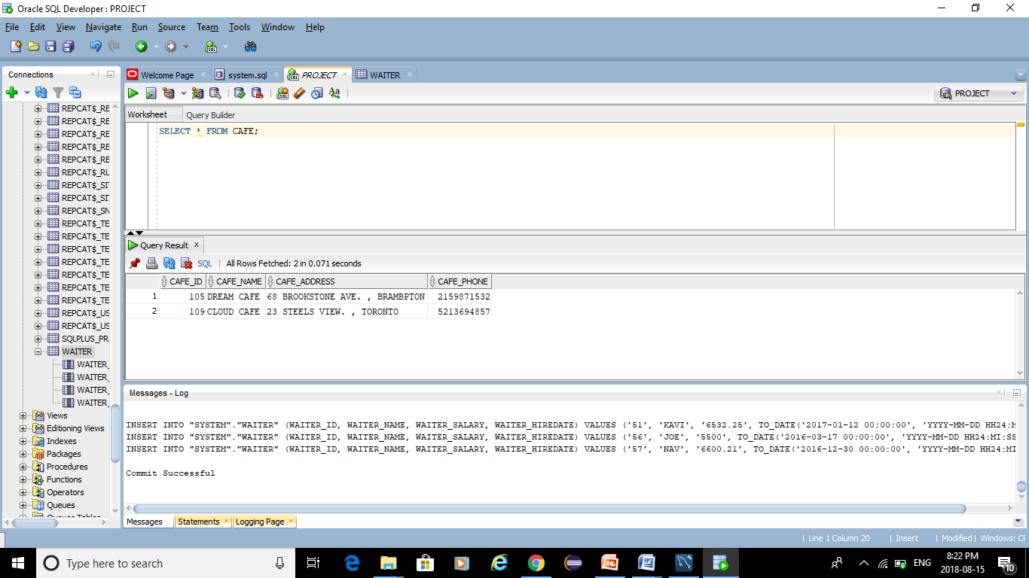
SCREENSHOTS:- CAFÉ TABLE

Slide 14

CHEF TABLE

Slide 15

WAITER TABLE

Slide 16
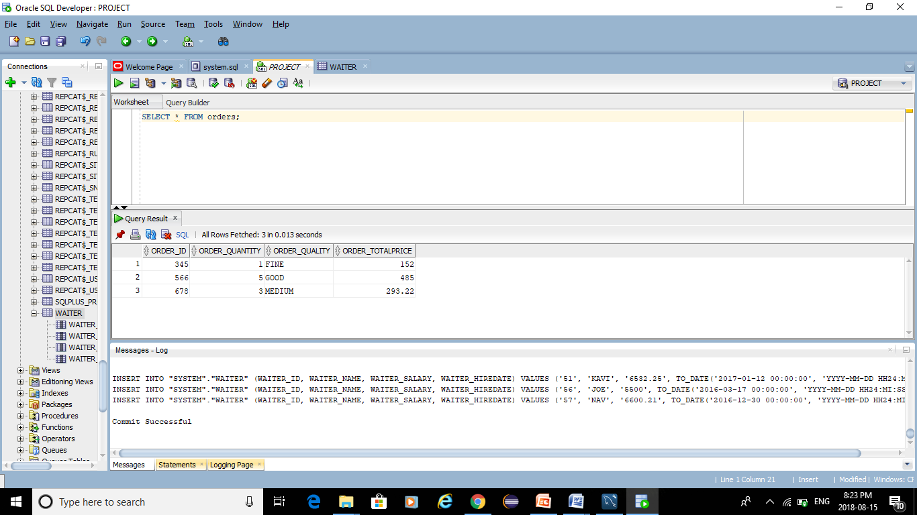
ORDERS TABLE

Slide 17


Slide 18

MEAK TABLE

Slide 19
CONSTRAINT Statements:-
alter table PROJECT.CAFE
add constraint CAFE_pk primary key(CAFE_NAME);
alter table PROJECT.CUSTOMER
add constraint CUSTOMER_pk primary key(CUSTOMER_ID);
alter table PROJECT.WAITER
add constraint WAITER_pk
primary key(WAITER_ID);
alter table PROJECT.WAITER
add constraint WAITER_fk Foreign key(CAFE_NAME)
references PROJECT.CAFE(CAFE_NAME);
alter table PROJECT. MEAL
add constraint MEAL_pk
primary key(MEAL_ID)
constraint MEAL_fk foreign key(WAITER_id)
references PRODUCT.WAITER(WAITER_ID);
alter table PROJECT.CHEF
add constraint CHEF_pk primary key(CHEF_ID);

Slide 20
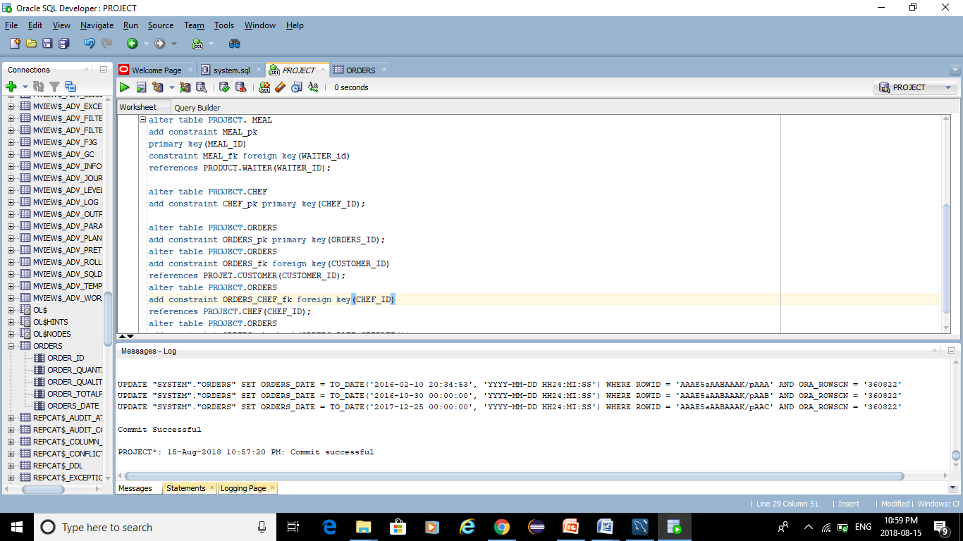
CONTINOUSE:-
alter table PROJECT.ORDERS
add constraint ORDERS_pk primary key(ORDERS_ID);
alter table PROJECT.ORDERS
add constraint ORDERS_fk foreign key(CUSTOMER_ID)
references PROJET.CUSTOMER(CUSTOMER_ID);
alter table PROJECT.ORDERS
add constraint ORDERS_CHEF_fk foreign key(CHEF_ID)
references PROJECT.CHEF(CHEF_ID);
alter table PROJECT.ORDERS
add constraint ORDERS_ck check(ORDERS_DATE<GETDATE());

Slide 21
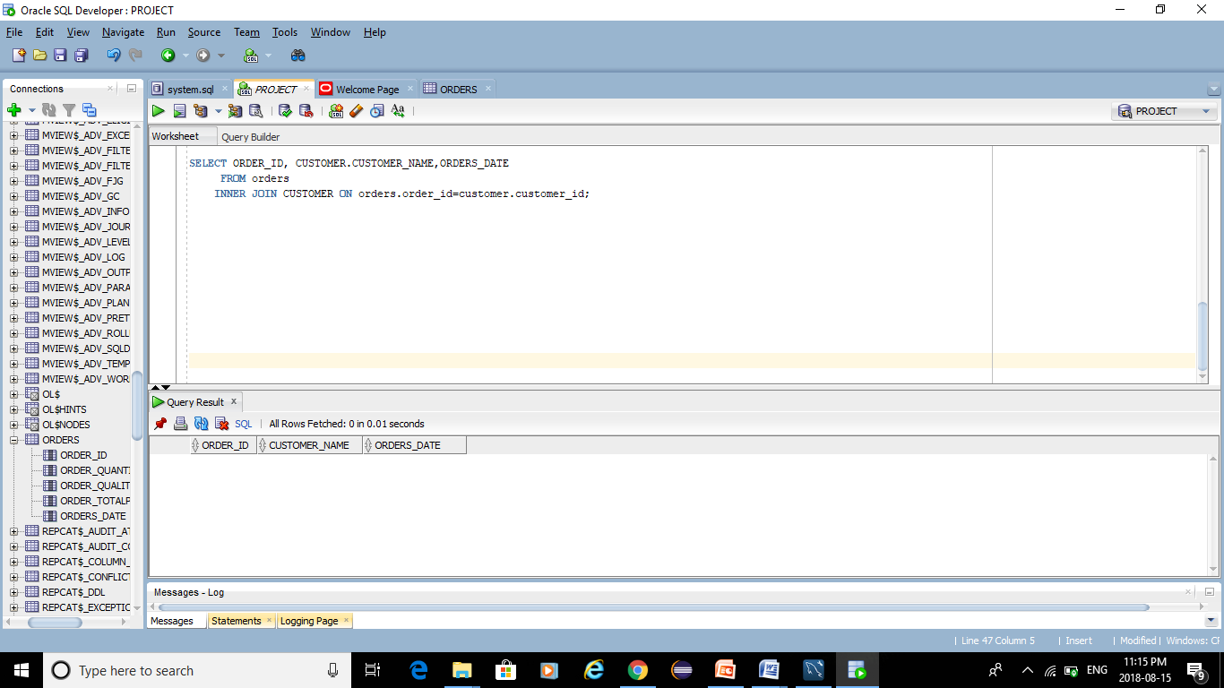
INNER JOIN:-

Slide 22
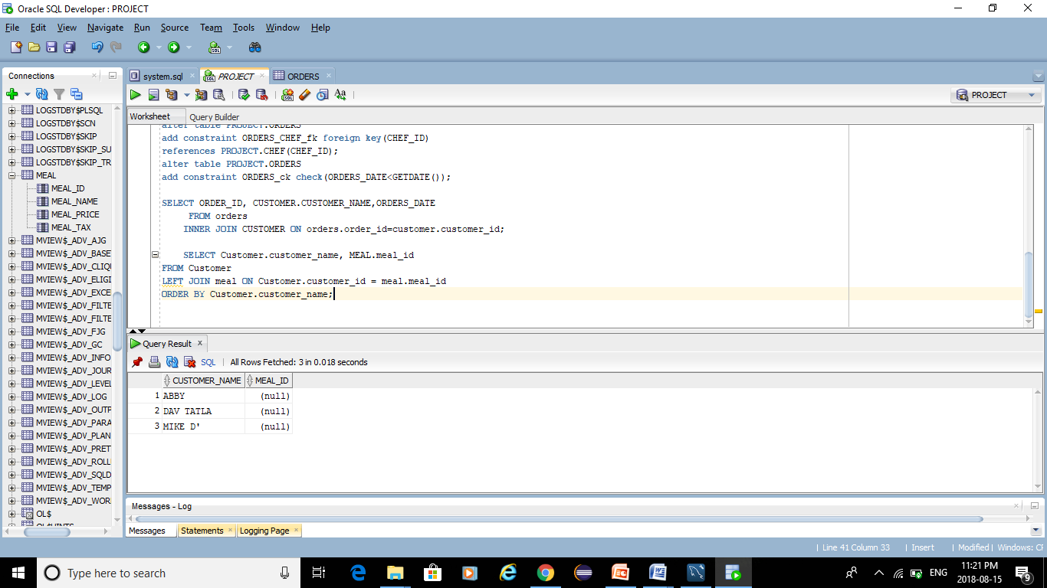
LEFT JOIN:-

Slide 23
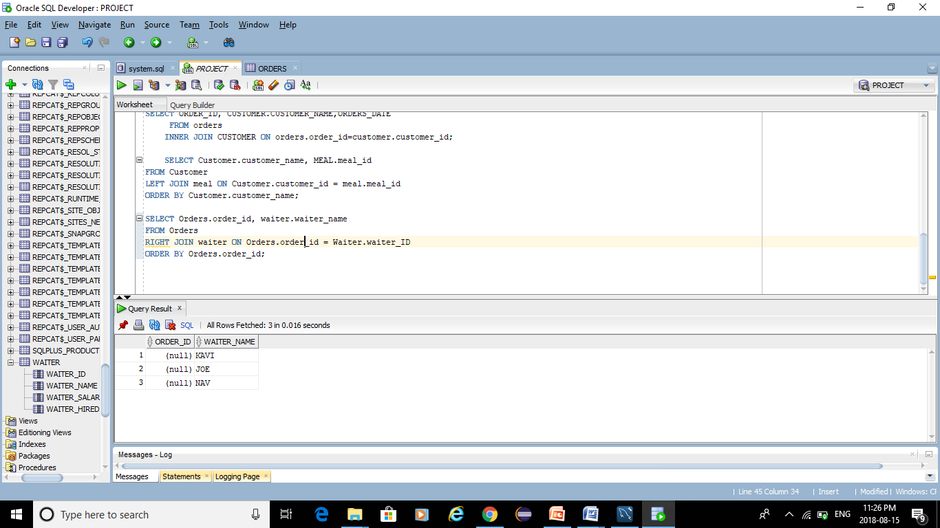
RIGHT JOIN:-

Slide 24

FULL JOIN:-

Slide 25
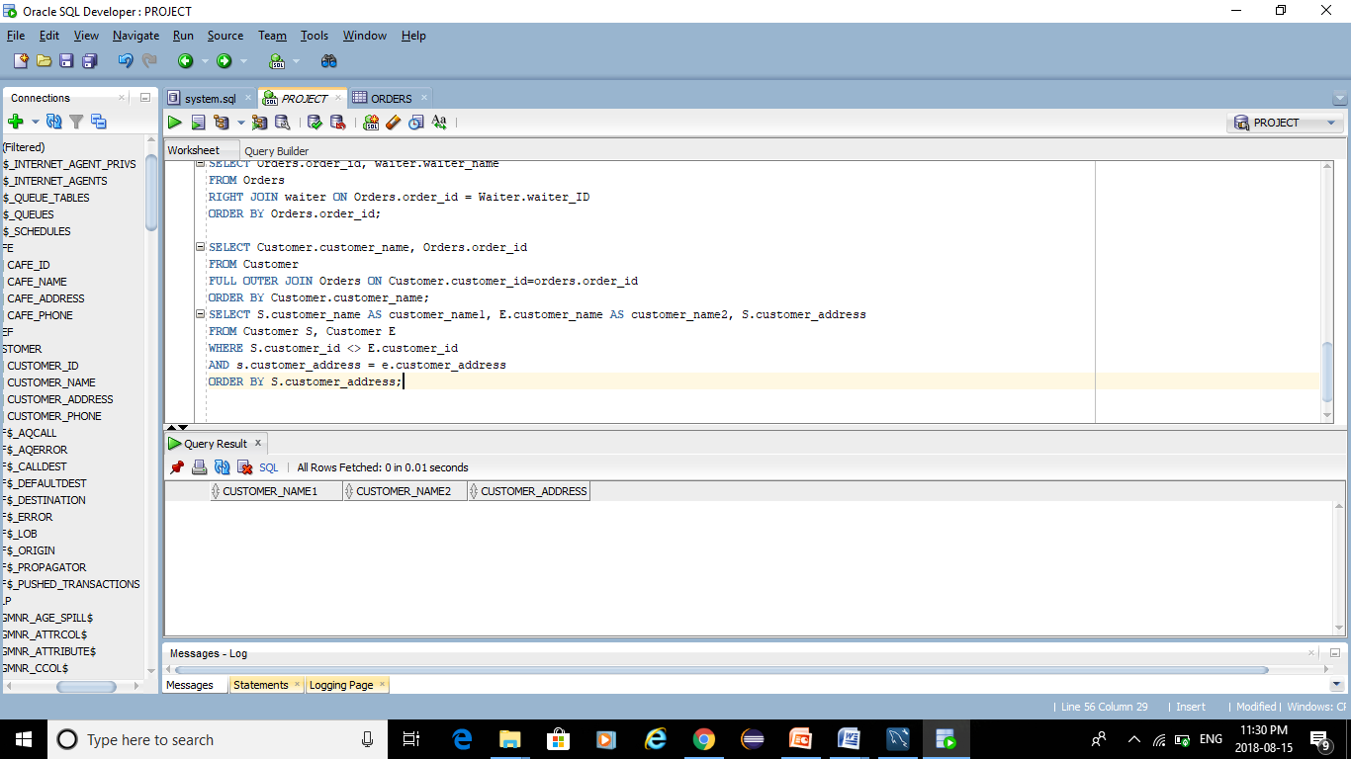
SELF JOIN:-

Slide 26
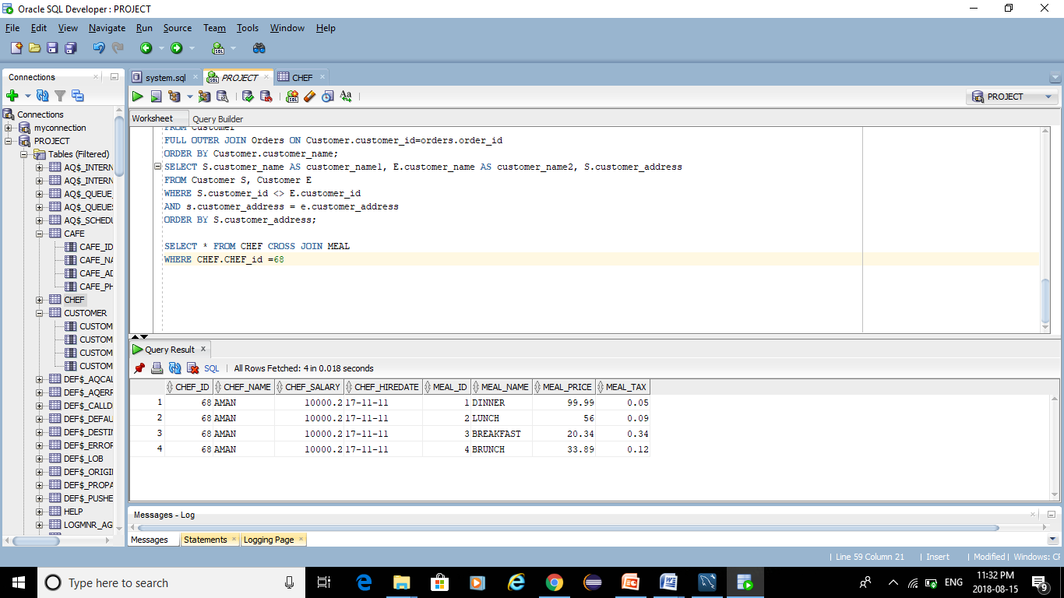
CROSS JOIN:-

Slide 27
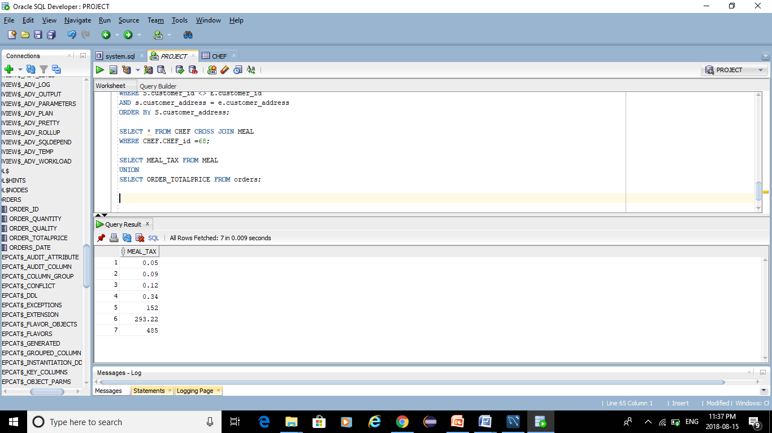
UNION:-

Slide 28
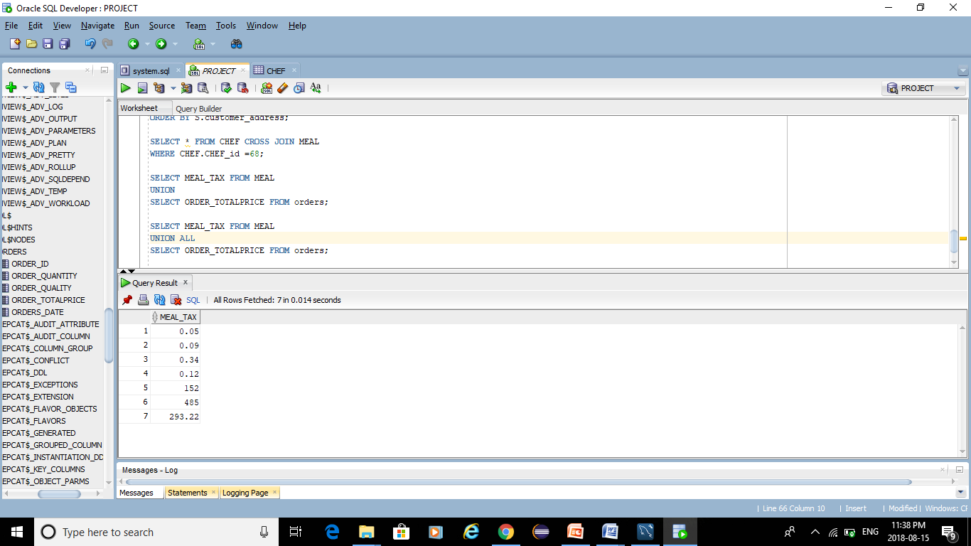
UNION ALL:-

Slide 29
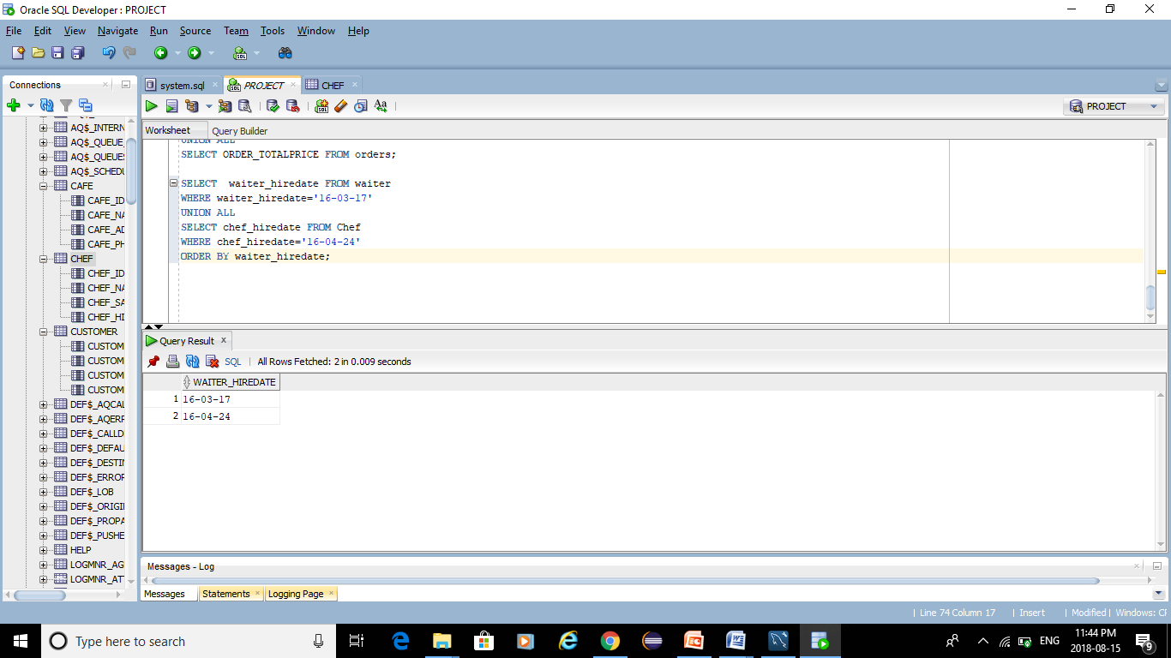
UNION ALL WITH WHERE :-

Slide 30
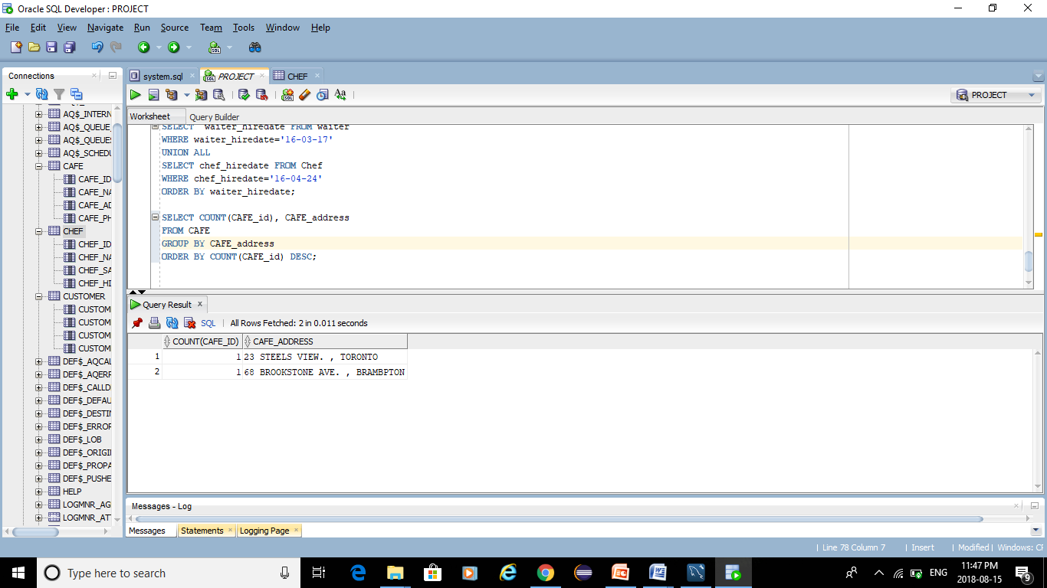
GROUP BY:-

Slide 31
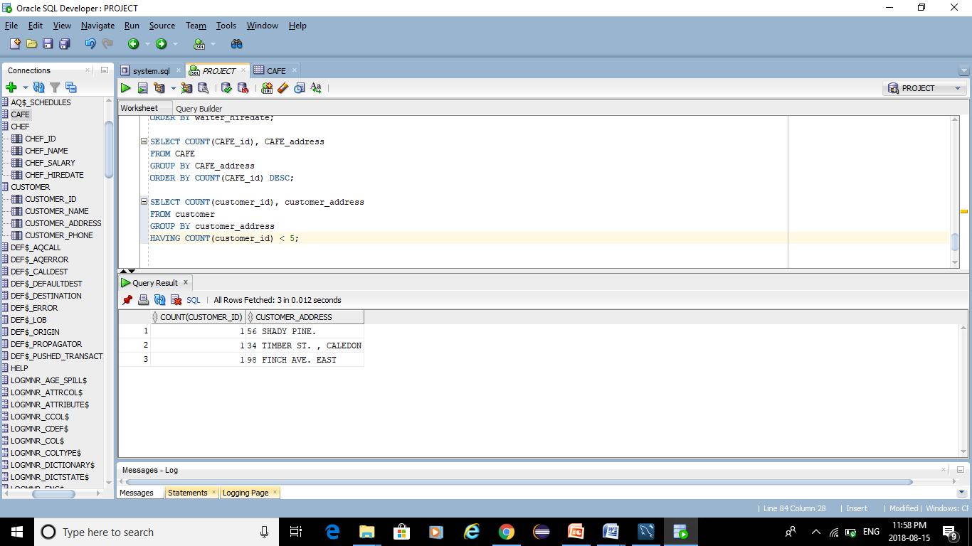
HAVING :-

Slide 32
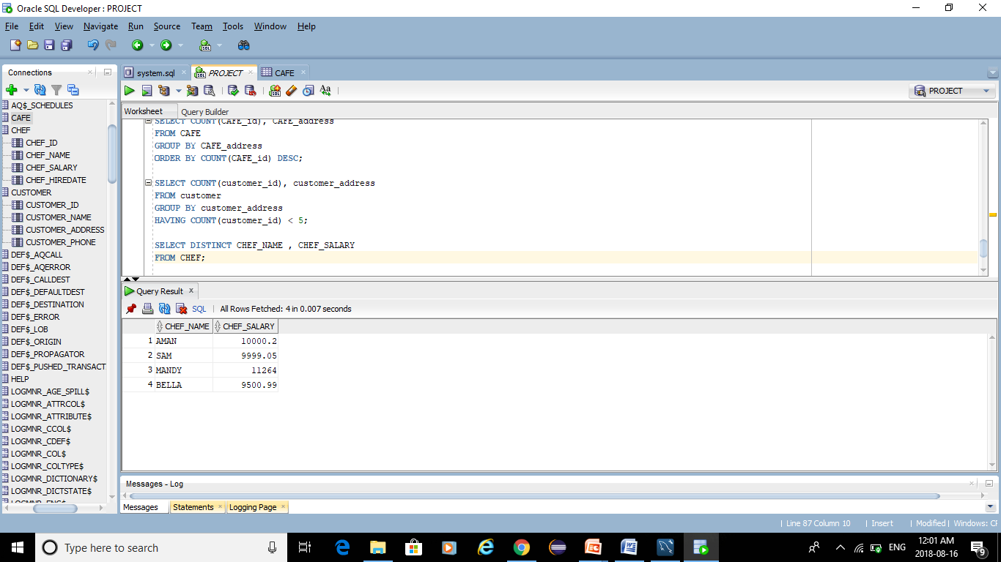
DISTINCT:-

Slide 33
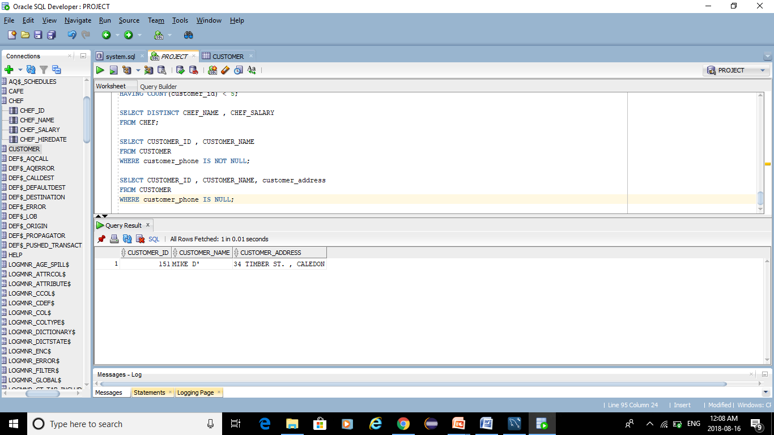
NULL CONDITION:-

Slide 34
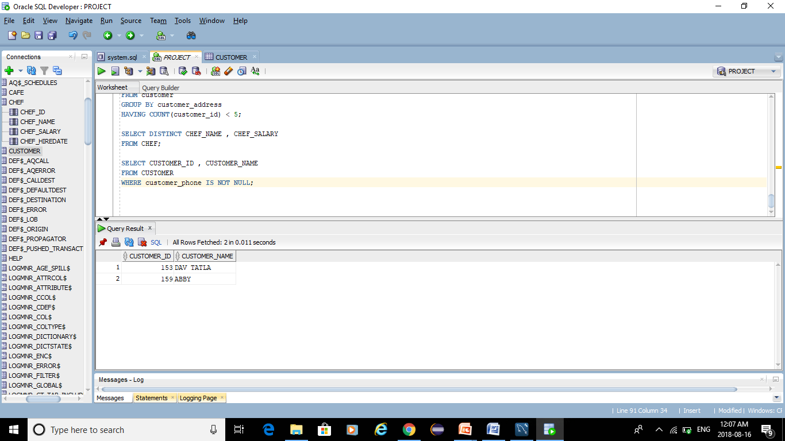
NOT NULL CONDITION:-

Slide 35
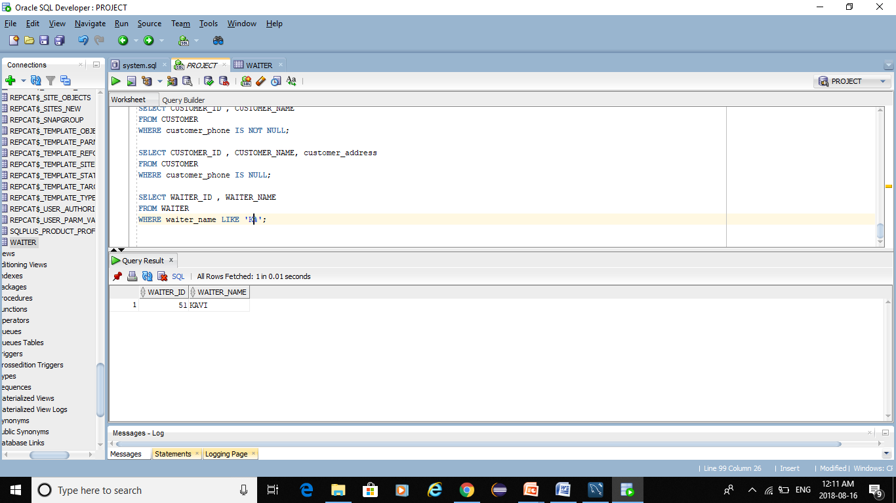
LIKE OPERATOR:-

Slide 36
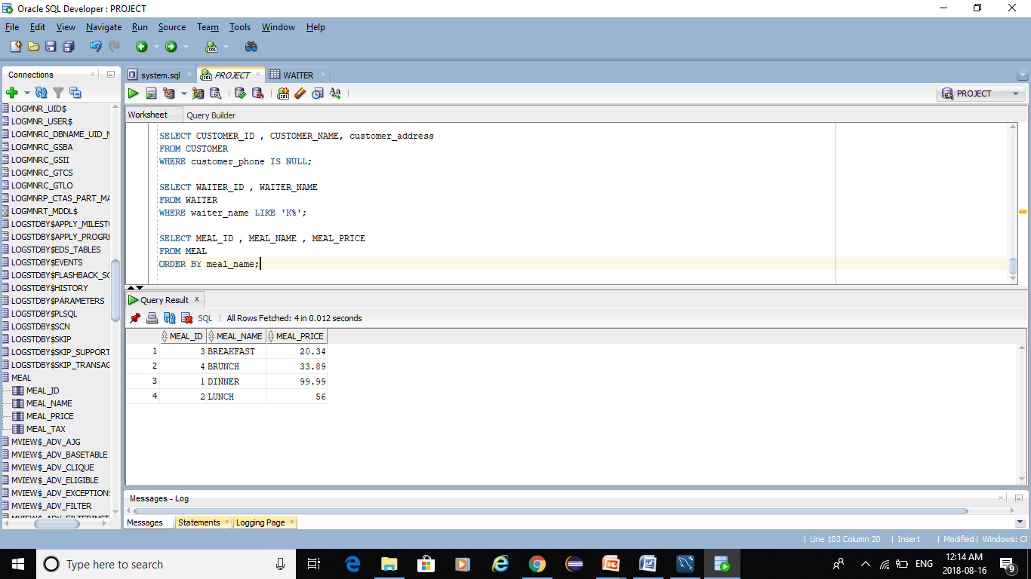
ORDER BY:-

Slide 37
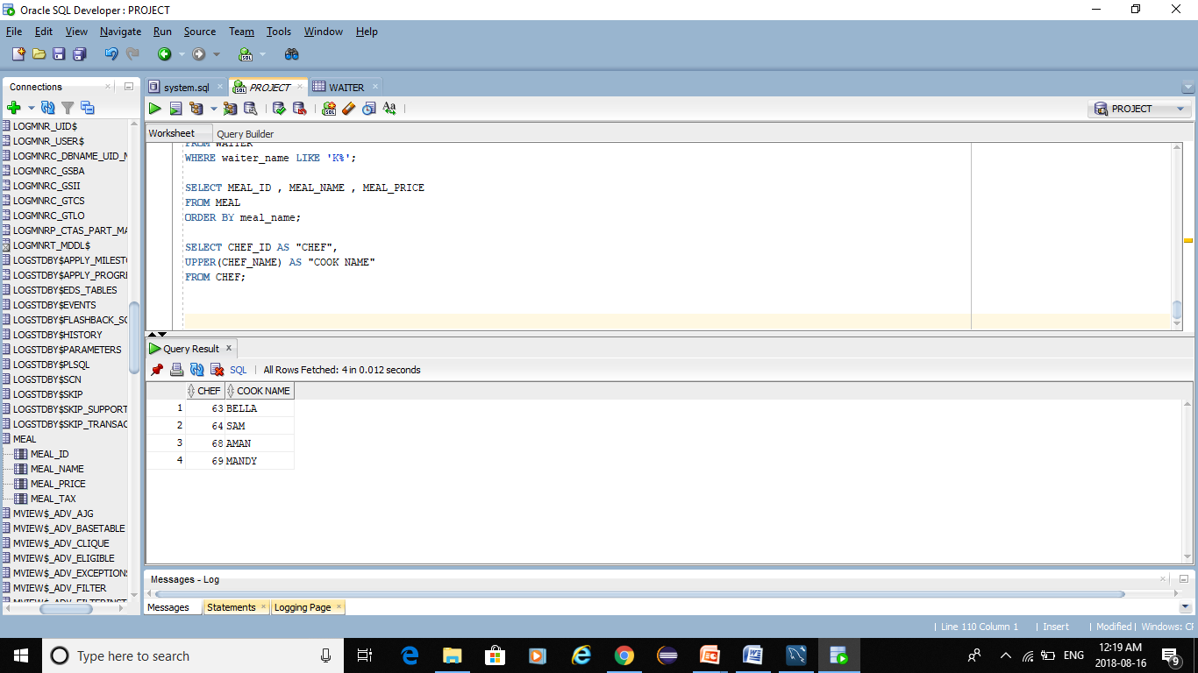
UPPER FUNCTION:-

Slide 38
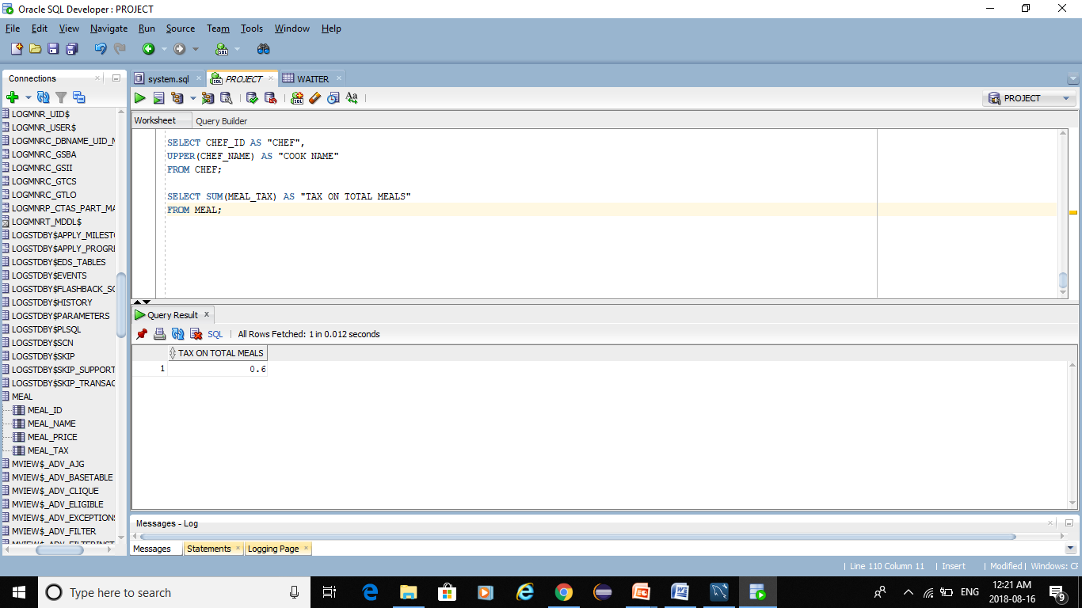
SUM FUNCTION:-

Slide 39
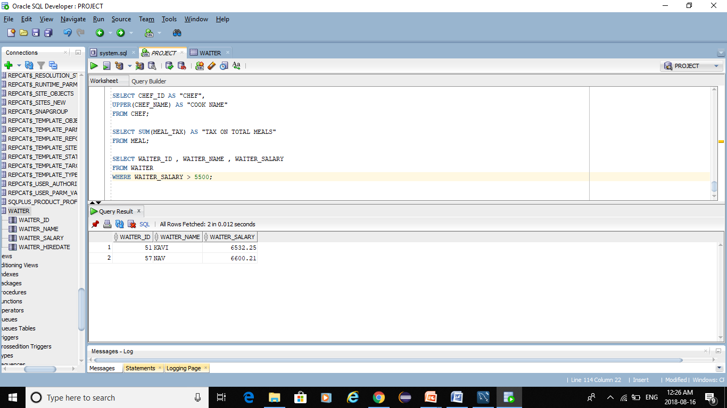
Single-Row Sub query:-

Slide 40
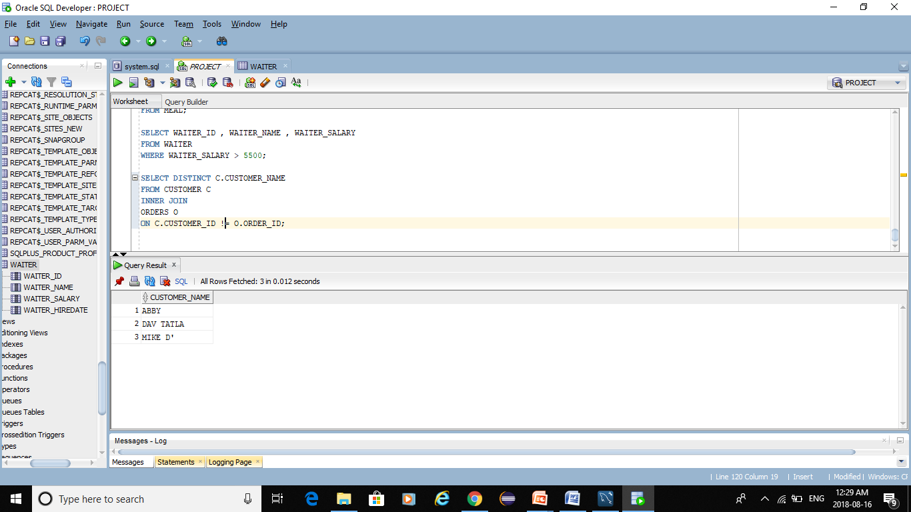
JOIN - order seems to be determined by the orders table

Slide 41
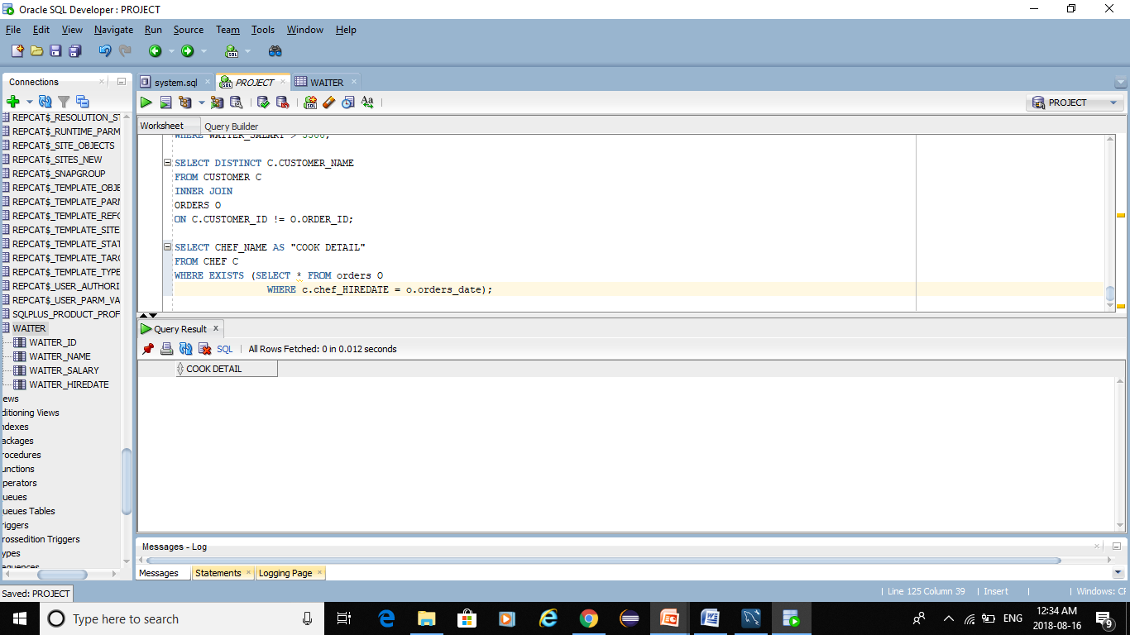
EXISTS OPERATOR:-

Slide 42
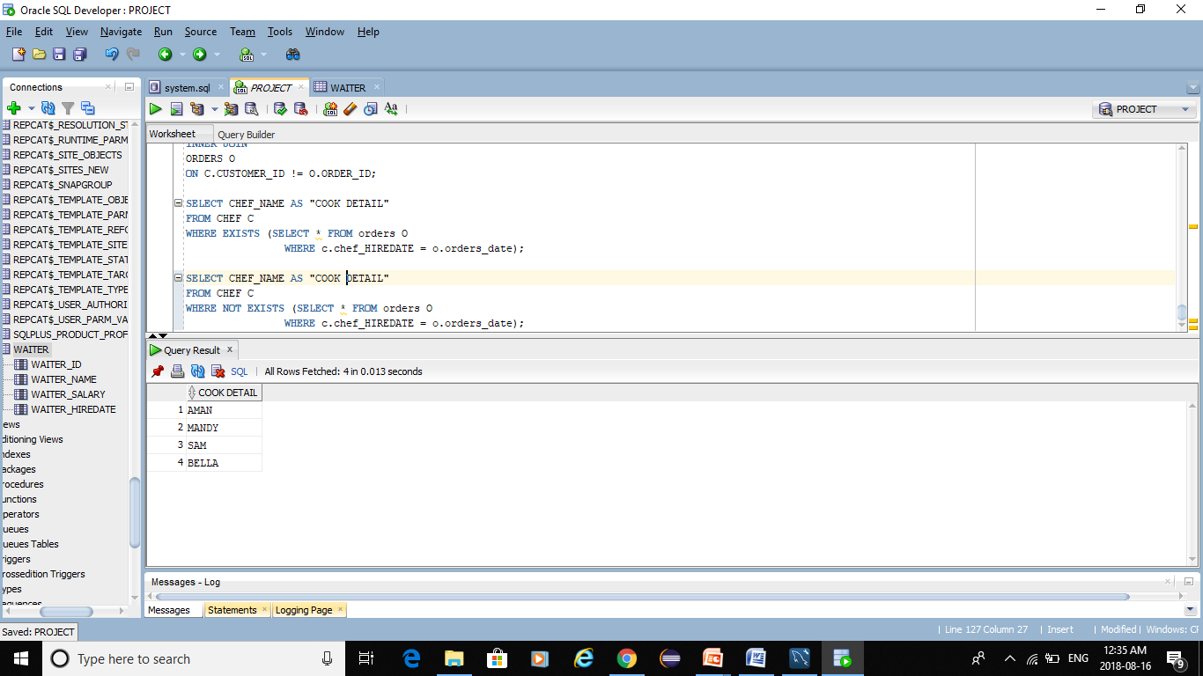
NOT EXISTS OPERATOR:-

